Slide 1
Electron Vertical Tunneling Emission by Detrapping from CTN

Slide 2
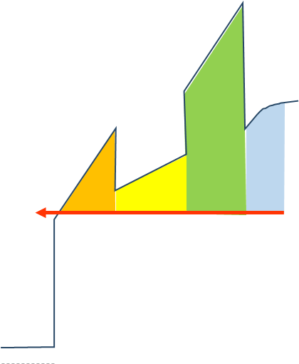
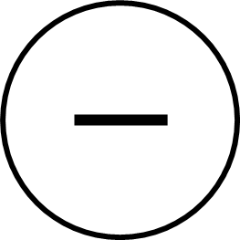
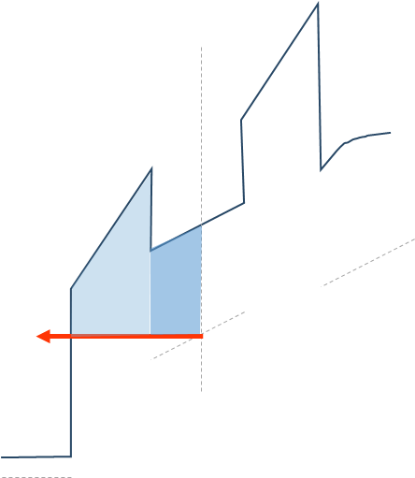







Detrapping from BETOX and CTN
CTN
BE-TOX (ONO)
CTN
$e_{n, CTN }$
ox1 layer
ox2 layer
n1 layer
$E_{Fi}$
$e_{n, CTN }$
$e_{n, BETOX}$
$E_{Fi}$
$e_{n, BETOX}$
BE-TOX (ONO)
$E_{Fi}$

Slide 3
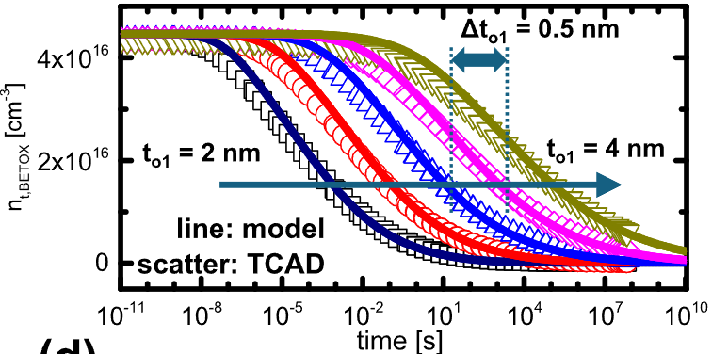
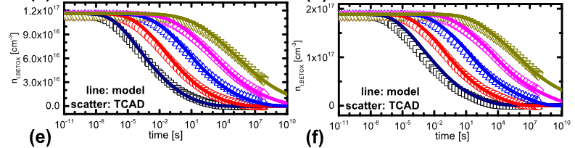



Review of Detrapping from BETOX
$e_{n, elastic}=\frac{2π}{ℏ} {\left|E_{T}\right|}^{2} V_{T} ∙\frac{\sqrt{2}}{π^{2}ℏ^{3}} \sqrt{m_{⊥}^{∗}} m_{0∥} \sqrt{E_{trap}−E_{c0}}\frac{1}{\exp\left(−\frac{E_{trap}−E_{Fi}}{kT}\right)+1} \left|TC\right|$
BE-TOX (ONO)
CTN
ox1 layer
ox2 layer
n1 layer
$e_{n, elastic}$
$E_{trap}$
Good agreement with model-TCAD [1]
$E_{Fi}$
[1] Jin, TED, 2025

Slide 4
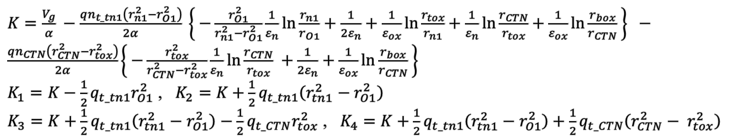
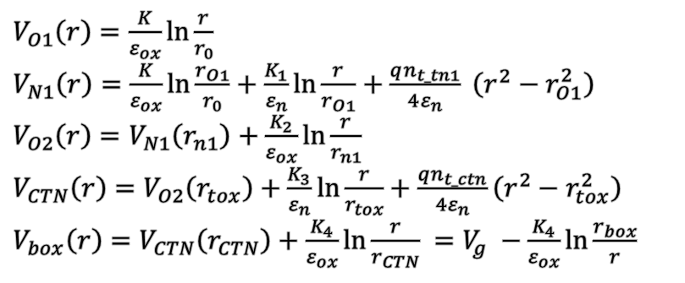
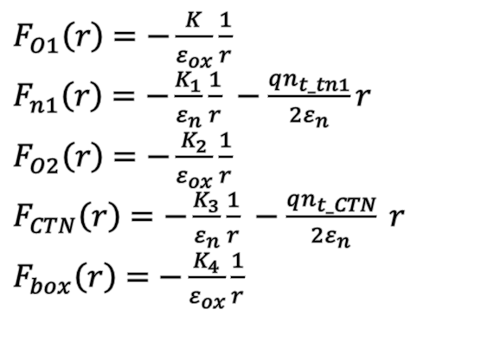
Review of Detrapping from BETOX
Used Poisson equation
$F_{O1}\left(r\right)=−\frac{K}{ε_{ox}}\frac{1}{r}$
$F_{n1}\left(r\right)=−\frac{K_{1}}{ε_{n}}\frac{1}{r} −\frac{qn_{t_tn1}}{2ε_{n}}r$
$F_{O2}\left(r\right)=−\frac{K_{2}}{ε_{ox}}\frac{1}{r}$
$F_{CTN}\left(r\right)=−\frac{K_{3}}{ε_{n}}\frac{1}{r} −\frac{qn_{t_CTN}}{2ε_{n}} r$
$F_{box}\left(r\right)=−\frac{K_{4}}{ε_{ox}}\frac{1}{r}$
$V_{O1}\left(r\right)=\frac{K}{ε_{ox}}\ln{\frac{r}{r_{0}}}$
$V_{N1}\left(r\right)=\frac{K}{ε_{ox}}\ln{\frac{r_{O1}}{r_{0}}}+\frac{K_{1}}{ε_{n}}\ln{\frac{r}{r_{O1}}}+\frac{qn_{t_tn1}}{4ε_{n}} \left(r^{2}−r_{O1}^{2}\right)$
$V_{O2}\left(r\right)=V_{N1}\left(r_{n1}\right)+\frac{K_{2}}{ε_{ox}}\ln{\frac{r}{r_{n1}}}$
$V_{CTN}\left(r\right)=V_{O2}\left(r_{tox}\right)+\frac{K_{3}}{ε_{n}}\ln{\frac{r}{r_{tox}}}+\frac{qn_{t_ctn}}{4ε_{n}}\left(r^{2}−r_{tox}^{2}\right)$
$V_{box}\left(r\right)=V_{CTN}\left(r_{CTN}\right)+\frac{K_{4}}{ε_{ox}}\ln{\frac{r}{r_{CTN}}} =V_{g} −\frac{K_{4}}{ε_{ox}}\ln{\frac{r_{box}}{r}}$
$K=\frac{V_{g}}{α} −\frac{qn_{t_tn1}\left(r_{n1}^{2}−r_{O1}^{2}\right)}{2α} \left\{ −\frac{r_{O1}^{2}}{r_{n1}^{2}−r_{O1}^{2}}\frac{1}{ε_{n}}\ln{\frac{r_{n1}}{r_{O1}}}+\frac{1}{2ε_{n}}+\frac{1}{ε_{ox}}\ln{\frac{r_{tox}}{r_{n1}}}+\frac{1}{ε_{n}}\ln{\frac{r_{CTN}}{r_{tox}}}+\frac{1}{ε_{ox}}\ln{\frac{r_{box}}{r_{CTN}}} \right\} −\frac{qn_{CTN}\left(r_{CTN}^{2}−r_{tox}^{2}\right)}{2α}\left\{ −\frac{r_{tox}^{2}}{r_{CTN}^{2}−r_{tox}^{2}}\frac{1}{ε_{n}}\ln{\frac{r_{CTN}}{r_{tox}}} +\frac{1}{2ε_{n}}+\frac{1}{ε_{ox}}\ln{\frac{r_{box}}{r_{CTN}}} \right\}$
$K_{1}=K−\frac{1}{2}q_{t_tn1}r_{O1}^{2}$ , $K_{2}=K+$ $\frac{1}{2}q_{t_tn1}\left(r_{tn1}^{2}−r_{O1}^{2}\right)$
$K_{3}=K+\frac{1}{2}q_{t_tn1}\left(r_{tn1}^{2}−r_{O1}^{2}\right)−\frac{1}{2}q_{t_CTN}r_{tox}^{2}$ , $K_{4}=K+\frac{1}{2}q_{t_tn1}\left(r_{tn1}^{2}−r_{O1}^{2}\right)+\frac{1}{2}q_{t_CTN}\left(r_{CTN}^{2}− r_{tox}^{2}\right)$
$α=\frac{1}{ε_{ox}}ln\frac{r_{o1}}{r_{o}}+\frac{1}{ε_{n}}ln\frac{r_{n1}}{r_{o1}}+\frac{1}{ε_{ox}} ln\frac{r_{tox}}{r_{n1}}+\frac{1}{ε_{n}}ln\frac{r_{ctn}}{r_{tox}}+\frac{1}{ε_{ox}} ln\frac{r_{box}}{r_{ctn}}$
[1] Jin, TED, 2025

Slide 5
CTN Trapped Charge Uniform Distribution
Detrapping mechanisms in retention of 3-D NAND flash vertical cross section
② CTN Detrapping to channel (Ch)
BETOX
CTN
BOX
③ CTN Detrapping to wordline (WL)
① BETOX Detrapping [1]
Ch
WL
[1] Jin, TED, 2025

Slide 6


CTN Electron Emission Simulation Method
① BETOX Detrapping [1]
From Last Research…
Vertical Partition Method
=> Uniform field assumption
② CTN Detrapping to Ch
③ CTN Detrapping to WL
CTN
Same Implementation!
Vertical Partition Method
=> Non-uniform field!
$e_{n, CTN }$
$E_{Fi}$

